Slide 1
Student Management System (REST API)

Slide 2
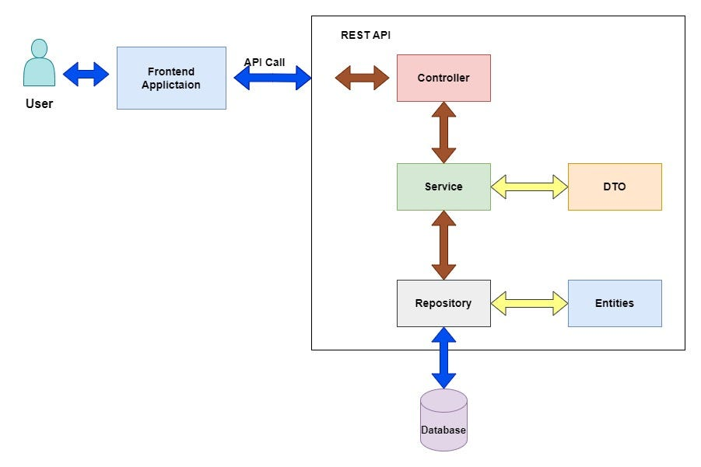

Slide 3
Project Description
This project manages student details like:
Add student
View students
Update student
Delete student

Slide 4
Project Architecture (Very Important for Exams)
Controller → Service → Repository → Database
Layer | Purpose | Annotation
Controller | Handles HTTP requests | @RestController
Service | Business logic | @Service
Repository | DB operations | @Repository
Entity | Table mapping | @Entity

Slide 5
Project Structure
student-management
└── src/main/java
└── com.example.student
├── StudentApplication.java
├── controller
│ └── StudentController.java
├── service
│ └── StudentService.java
├── repository
│ └── StudentRepository.java
└── model
└── Student.java

Slide 6
1. Main Class (Starts the Spring Boot application)
@SpringBootApplication
public class StudentApplication {
public static void main(String[] args) {
SpringApplication.run(StudentApplication.class, args);
}
}

Slide 7
2. Entity Class (Student) (Maps class to database table)
@Entity
public class Student {
@Id
@GeneratedValue(strategy = GenerationType.IDENTITY)
private int id;
private String name;
private String department;
// getters and setters
}

Slide 8
3. Repository Layer (Handles CRUD operations automatically)
@Repository
public interface StudentRepository
extends JpaRepository<Student, Integer> {
}

Slide 9
4. Service Layer (Contains business logic)
@Service
public class StudentService {
@Autowired
private StudentRepository repo;
public Student saveStudent(Student s) {
return repo.save(s);
}
public List<Student> getStudents() {
return repo.findAll();
}
}

Slide 10
5. Controller Layer (Handles HTTP requests)
@RestController
@RequestMapping("/students")
public class StudentController {
@Autowired
private StudentService service;
@PostMapping("/add")
public Student addStudent(@RequestBody Student s) {
return service.saveStudent(s);
}
@GetMapping("/all")
public List<Student> getAll() {
return service.getStudents();
}
}

Slide 11
application.properties (Configuring mysql)
server.port=8080
spring.datasource.url=jdbc:mysql://localhost:3306/studentdb
spring.datasource.username=root
spring.datasource.password=root
spring.jpa.hibernate.ddl-auto=update

